Slide 1
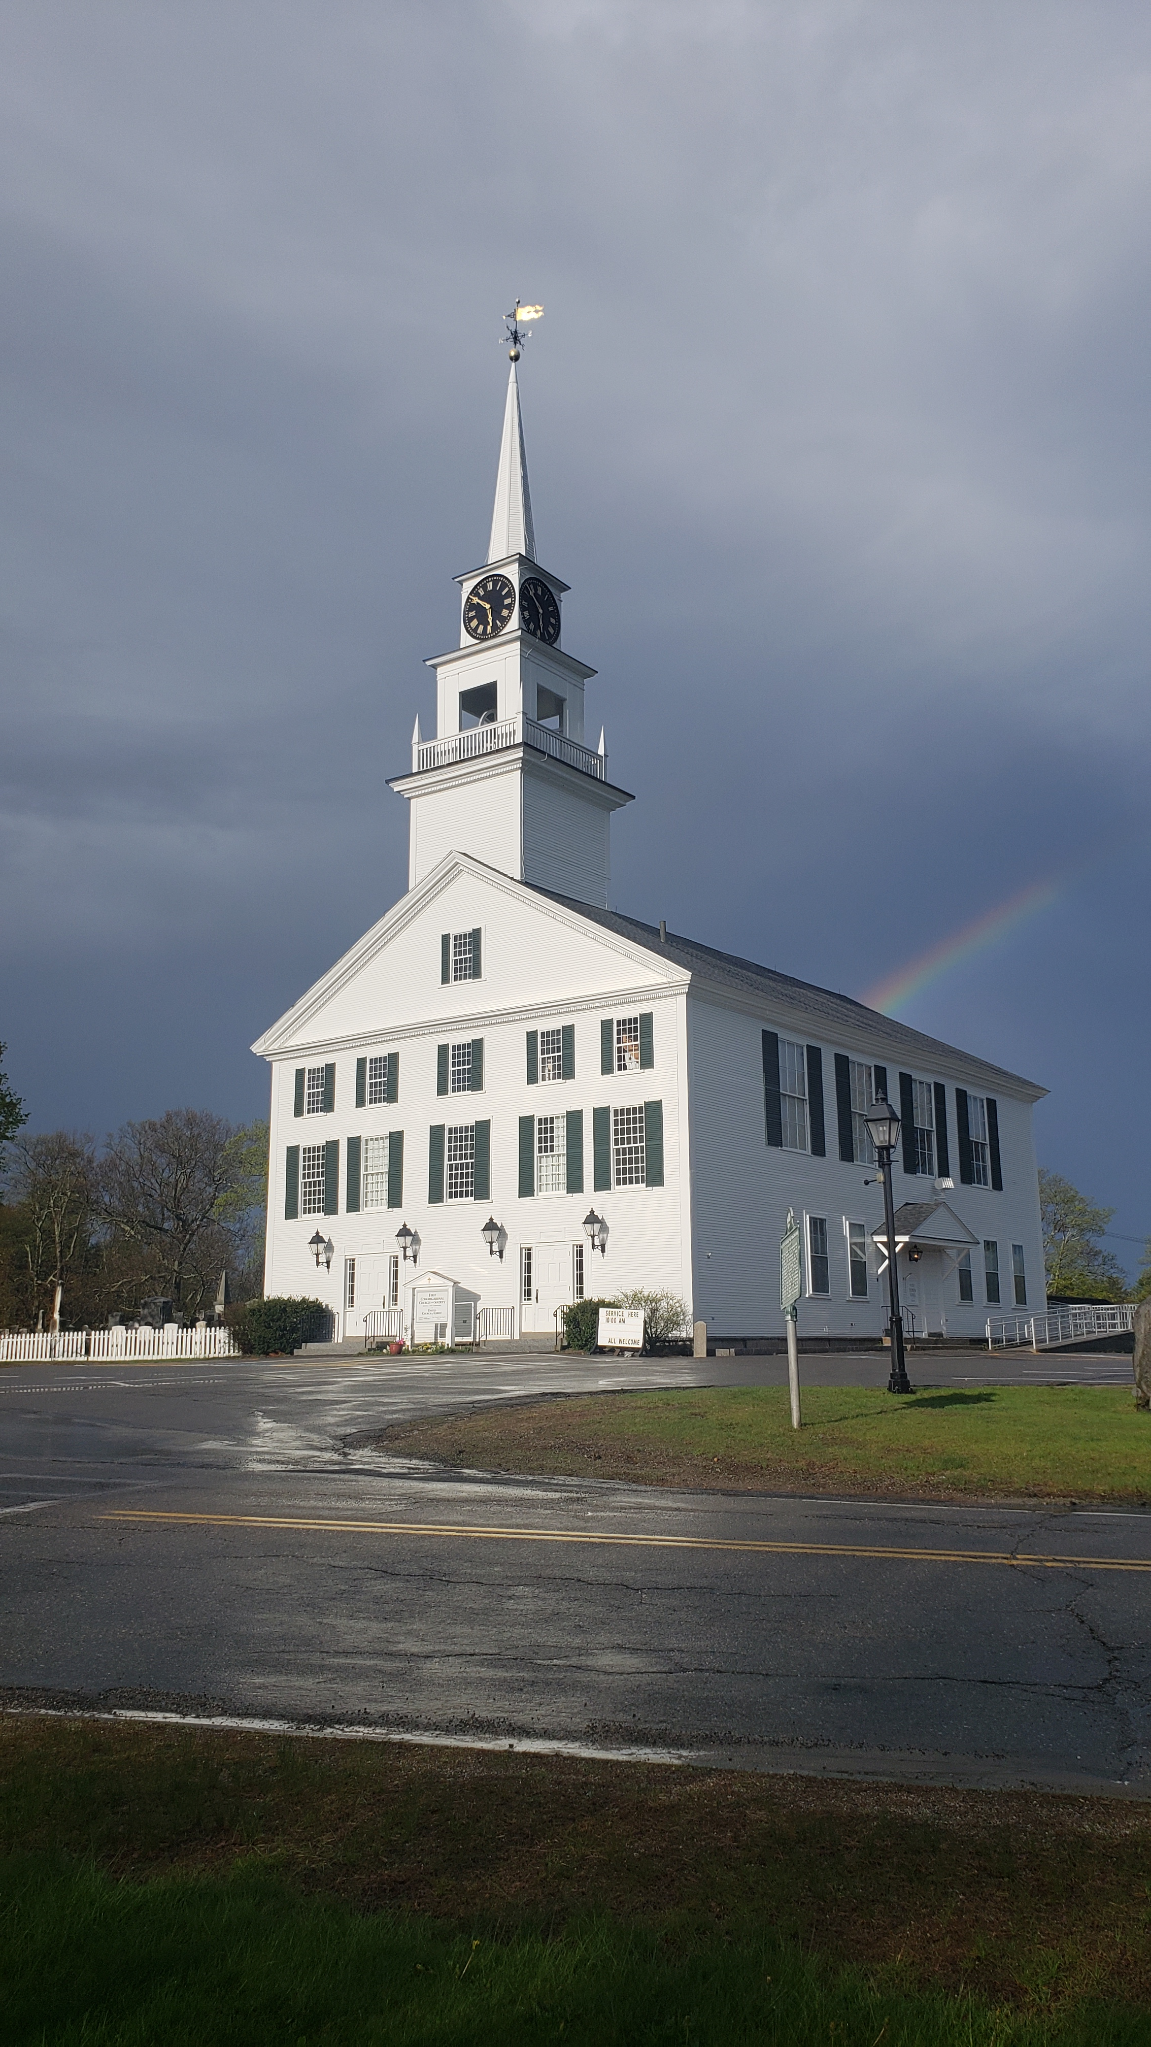
2026 Town of Rindge Deliberative Session
Saturday, January 31st, 2026, at 9:00 a.m. in the Rindge Memorial School Gymnasium, 58 School Street, Rindge, NH 03461

Slide 2

PURPOSE OF THE DELIBERATIVE SESSION
The Deliberative Session consists of explanation, discussion, and debate of articles and will afford those voters who are present the opportunity to propose, debate, and adopt amendments to each warrant article, except the election of officers and warrant articles whose wording is prescribed by state law.

Slide 3
Article 1 – Officers of the Year Ensuing
Position | # of Seats Open | Term Length
Board of Selectmen | 1 seat | 3 Year Term
Planning Board | 2 seats | 3 Year Term
Budget Advisory Committee | 2 seats | 3 Year Term
Zoning Board of Adjustment | 2 seats | 3 Year Term
Cemetery Trustee | 1 seat | 3 Year Term
Trustee of the Trust Funds | 1 seat | 3 Year Term
Ingalls Memorial Library Trustee | 1 seat | 3 Year Term
Town Moderator | 1 seat | 2 Year Term
Town Clerk | 1 seat | 3 Year Term
Tax Collector | 1 seat | 3 Year Term
Supervisor of the Checklist | 1 seat | 6 Year Term
Treasurer | 1 seat | 3 Year Term

Slide 4
Article 2 is a Zoning Article

Slide 5
Article 3 – Operating Budget
To see if the Town shall vote to raise and appropriate as an operating budget, not including appropriations by special warrant articles and other appropriations voted separately, the amounts set forth on the budget posted with the warrant or as amended by vote of the first session, for the purposes set forth therein, totaling Five Million Six Hundred Seventy Thousand Dollars ($5,670,000). Should this Article be defeated, the Default Budget shall be Five Million Six Hundred Fifty-Four Thousand One Hundred Seventy-Seven Dollars ($5,654,177) which is the same as last year with certain adjustments required by previous action of the Town of Rindge or by law; or the governing body may hold one special meeting, in accordance with RSA 40:13, X and XVI, to take up the issue of a revised operating budget only. (Recommended by the Selectmen 3 in favor, 0 opposed). (Recommended by the Budget Advisory Committee 7 in favor, 0 opposed).

Slide 6
Article 3 – Operating Budget
Major Increases to the Operating Budget:
  $50,000 increase to Mutual Aid
  $34,000 increase in Solid Waste removal
  $10,000 increase in Town’s Liability Insurance
  $7,000 increase in Workers’ Compensation
  $8,000 increase in the Health Reimbursement Account (HRA)
All of these increases are mandatory. Despite these increases, the 2026 Proposed Budget is only $44,722 over the 2025 Proposed Budget.
Sacrifices made –
DPW Director, Mike Cloutier, reduced his budget by $20,000 & offered to give up his raise.
The New Fire Chief, Bob Faas, decided to find healthcare from an alternative source, which saves the Town $25,000.

Slide 7
Article 3 – Operating Budget
Budget Comparison - 2026 Default to 2026 Proposed
 | 2026 Default | 2026 Proposed | $ Change | % Change
Total Operating Expenditures | $ 2,097,110.78 | $ 2,092,642.84 | $ (4,467.94) | -0.21%
Total Wages and Benefits | $ 3,557,065.78 | $ 3,577,364.43 | $ 20,298.65 | 0.57%
Total: | $ 5,654,176.78 | $ 5,670,000.00 | $ 15,823.22 | 0.28%

Slide 8
Article 3 – Operating Budget
Budget Comparison - 2025 Default/Original to 2026 Proposed
 | 2025 Budget - Default | 2026 Proposed | $ Change | % Change
Total Operating Expenditures | $ 1,948,893.00 | $ 2,092,642.84 | $ 143,749.84 | 7.38%
Total Wages and Benefits | $ 3,541,539.00 | $ 3,577,364.43 | $ 35,825.43 | 1.01%
Total: | $ 5,487,882.00 | $ 5,670,000.00 | $ 182,118.00 | 3.32%

Slide 9
Article 3 – Operating Budget
Budget Comparison - 2025 Default/Original to 2026 Default
 | 2025 Budget - Default | 2026 Default | $ Change | % Change
Total Operating Expenditures | $ 1,948,893.00 | $ 2,097,110.78 | $ 148,217.78 | 7.61%
Total Wages and Benefits | $ 3,541,539.00 | $ 3,557,065.78 | $ 15,526.78 | 0.44%
Total: | $ 5,487,882.00 | $ 5,654,176.78 | $ 166,294.78 | 3.03%

Slide 10
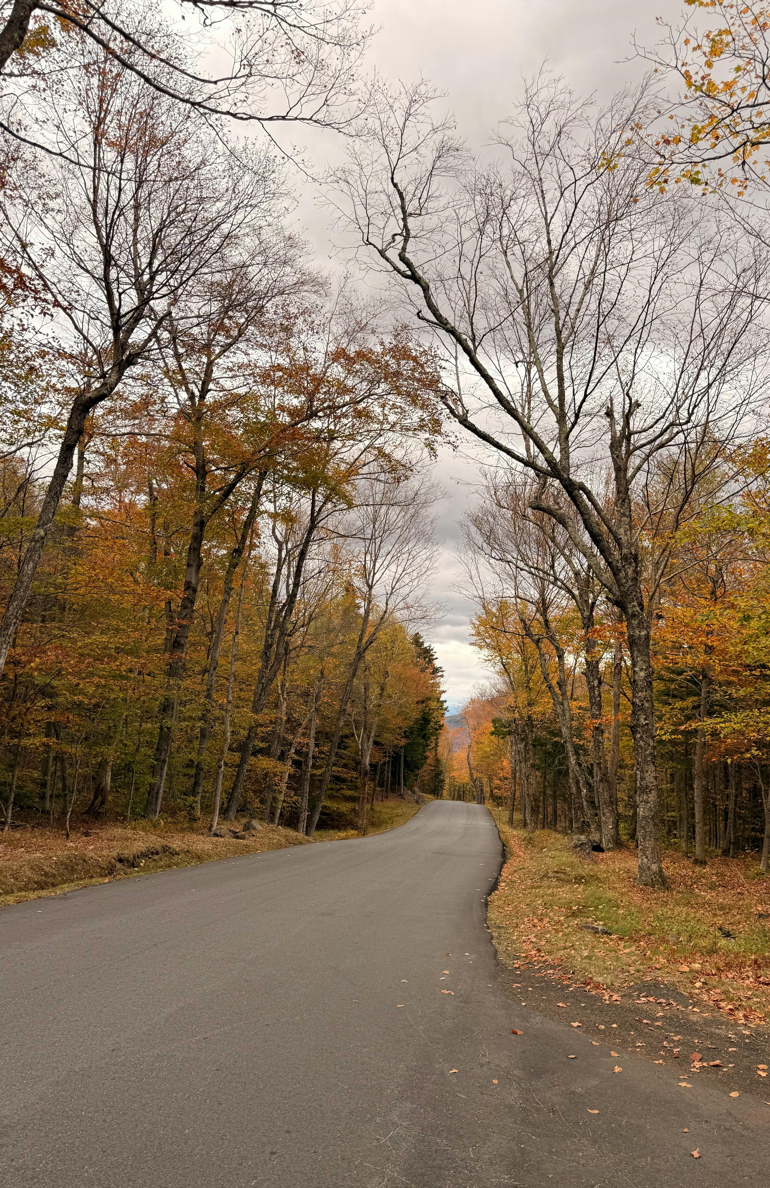
Article 4 – Highway Department CRF
To see if the Town shall vote to raise and appropriate the sum of One Hundred Eighty-Five Thousand Dollars ($185,000) to be added to the Highway Department Equipment Fund previously established, and further to name the Board of Selectmen as agents to expend from said fund. (Majority vote required). Recommended by the Board of Selectmen, 3 in favor, 0 opposed). (Recommended by the Budget Advisory Committee, 7 in favor, 0 opposed).

Slide 11
Article 4 – Highway Department CRF
The intended and planned use of these funds is to replace an 11-year-old 6-wheeler that is used as a dump truck and a plow.
Maintenance Cost of the Truck for the past 5 years was more than $50,000.
Total Unit Cost of the Truck | $243,521.00
Minus the CURRENT Trade in Value | - $27,000
Total Balance to be Paid | = $216,521
Minus Funds from Current Capital Reserves | - $31,521
TOTAL Funds to be Raised: | = $185,000

Slide 12
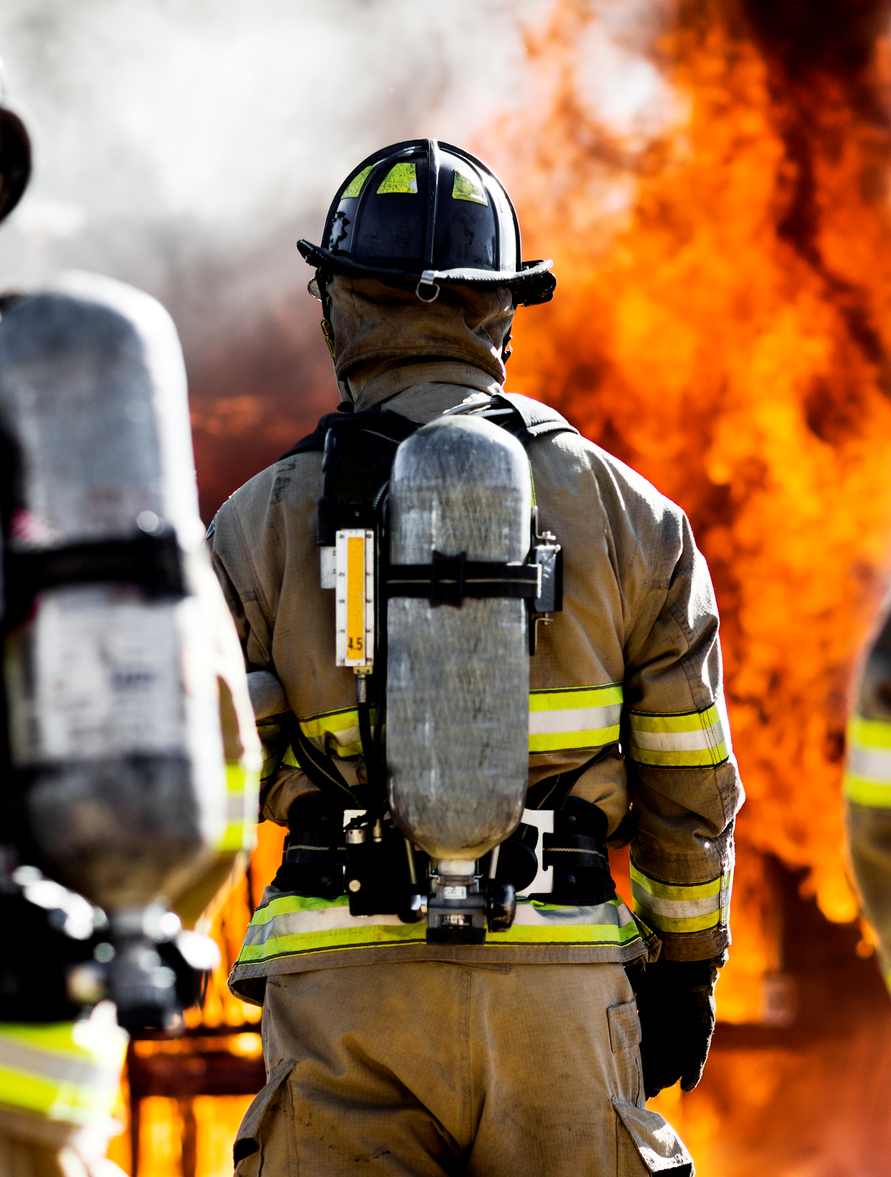
Article 5 – Fire Department Equipment CRF
To see if the Town shall vote to raise and appropriate the sum of One Hundred Twenty-Five Thousand Dollars ($125,000) to be added to the Fire Department Equipment Capital Reserve Fund previously established. (Majority vote required). (Recommended by the Board of Selectmen, 3 in favor, 0 opposed). (Recommended by the Budget Advisory Committee, 7 in favor, 0 opposed).

Slide 13
Article 5 – Fire Department Equipment CRF
The intended and planned use of these funds is to replace a Brush Truck that is more than 25 years old.
WHY SHOULD IT BE REPLACED?
The Current Brush Truck:
  Does not meet current National Fire Protection Association (NFPA) standards
  High risk of mechanical failure = risk to public safety and firefighter safety
  Very difficult to source replacement parts
  High maintenance costs – no longer cost-effective
  Increase in repair frequency and time out of commission

Slide 14
Article 5 – Fire Department Equipment CRF
WHAT IS A BRUSH TRUCK USED FOR?
  Rapid initial attack on brush and wildland fires
  First-due or primary access to narrow, unimproved, or off-road areas
  Protection of residents located in wooded and rural settings
  Support of mutual aid and regional wildfire response
WHAT WILL A NEW BRUSH TRUCK DO?
  Improve reliability in response
  Meet current NFPA and industry standards
  Be compatible with regional mutual aid
  Have increased pump capacity and water supply capabilities
  Have manufacturer support and warranty coverage
  Minimize risk and reduce the high maintenance costs

Slide 15

Article 6 – Ambulance Service ETF
To see if the Town shall vote to raise and appropriate the sum of Forty Thousand Dollars ($40,000) to add to the Ambulance Service Expendable Trust Fund previously established for the purpose of providing additional funds for ambulance services. (Recommended by the Board of Selectmen, 3 in favor, 0 opposed). (Recommended by the Budget Advisory Committee, 7 in favor, 0 opposed).

Slide 16
Article 6 – Ambulance Service ETF
This warrant article will bring the total funds appropriated for ambulance services to $125,000. At this time, the Town has reached an agreement with JRMA for ambulance services. The contract will remain for the duration of the year as long as both parties adhere to its provisions.

Slide 17
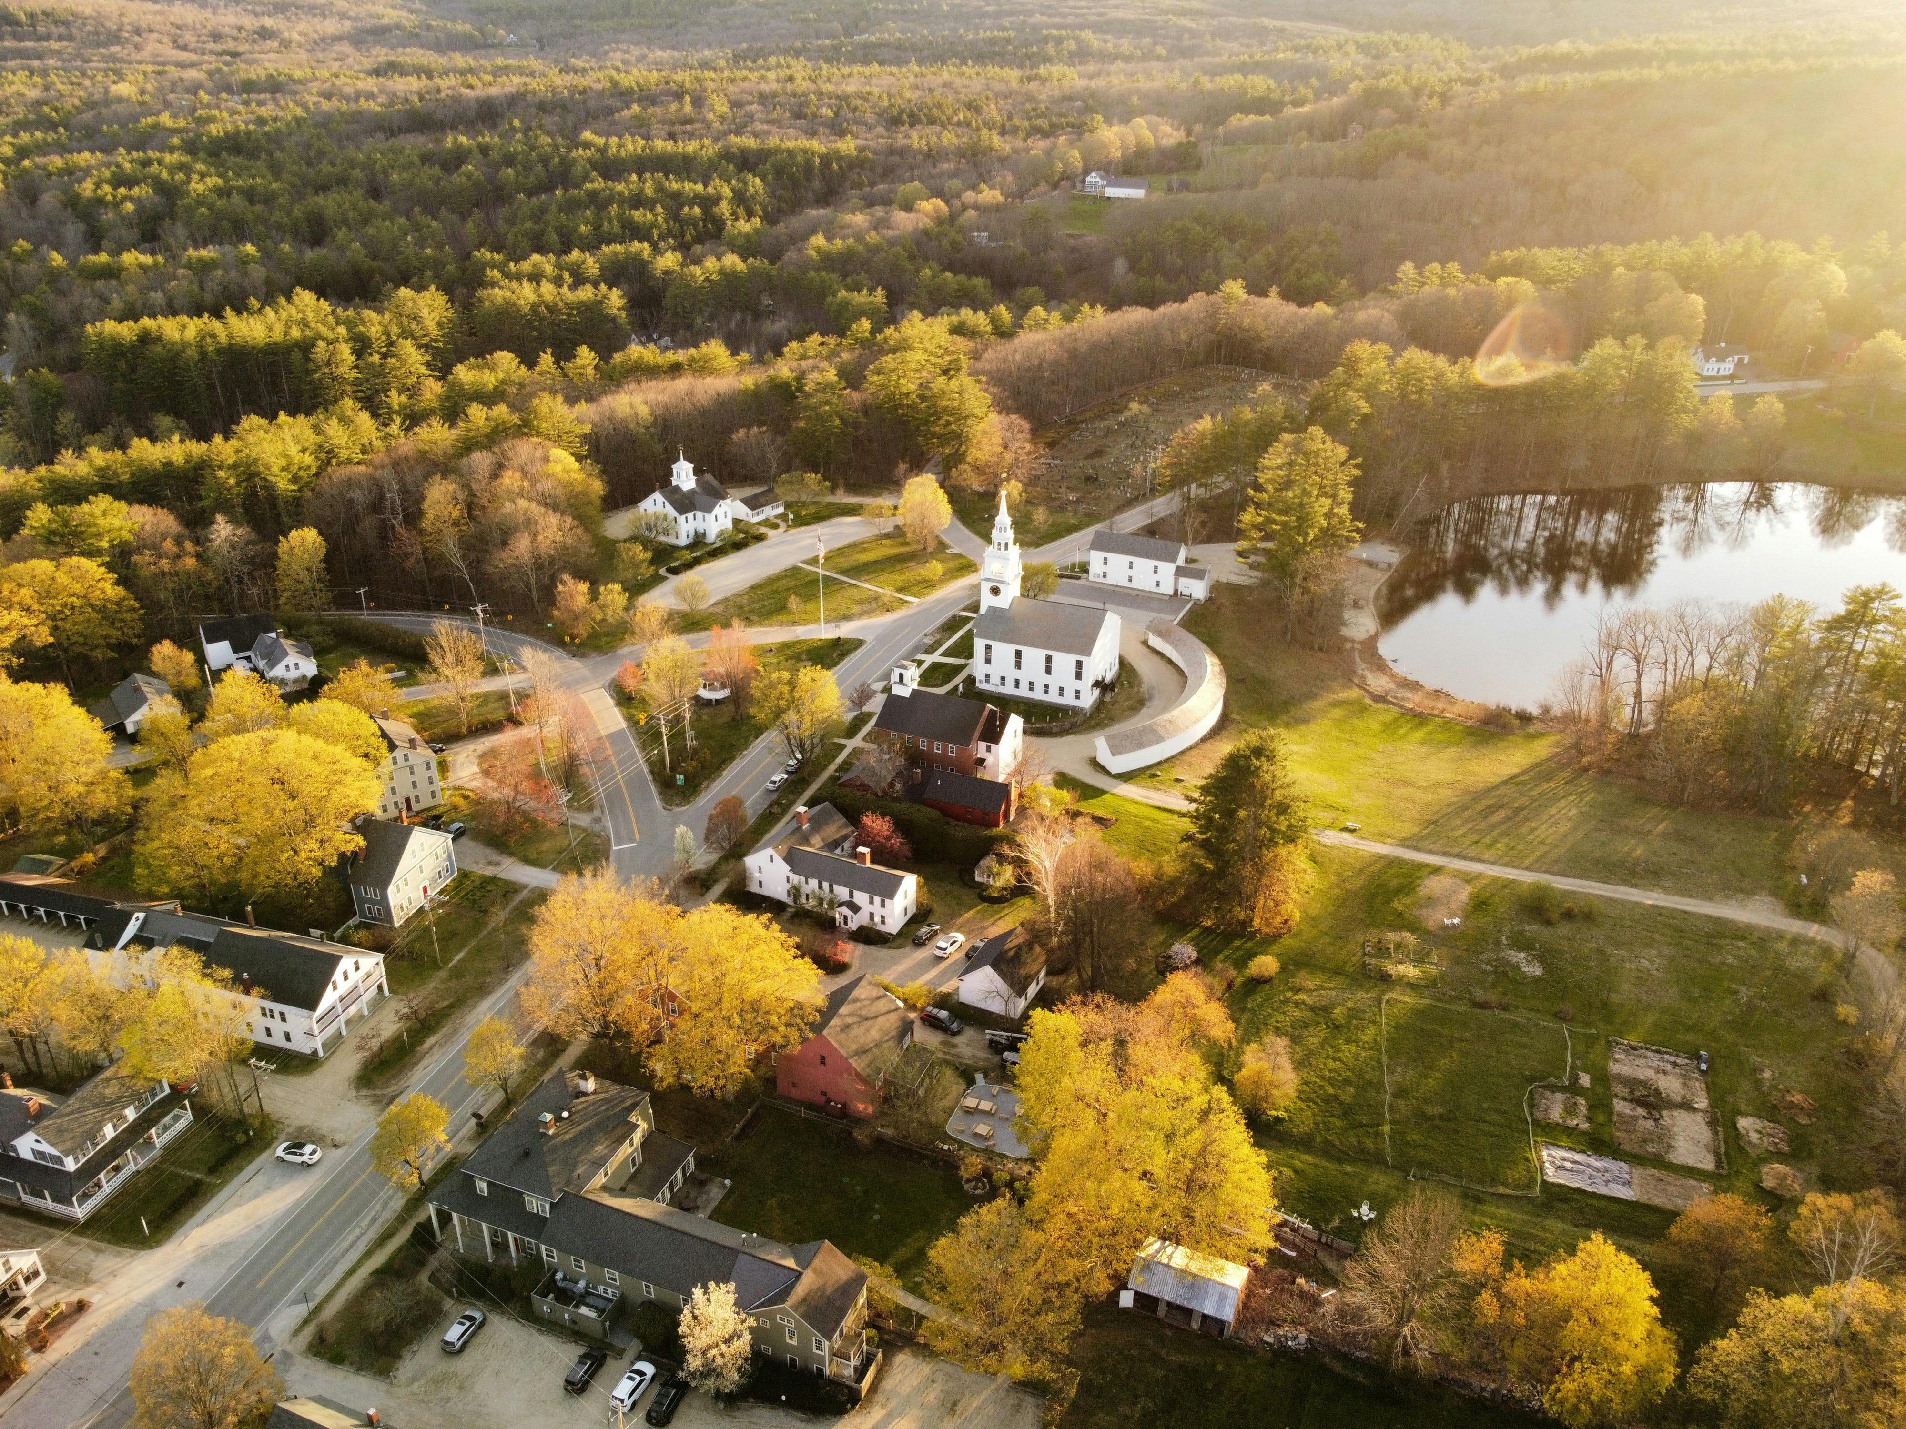
Article 7 – Building Maintenance CRF
To see if the Town shall vote to raise and appropriate the sum of Thirty-Five Thousand Dollars ($35,000) to be added to the Building Maintenance Capital Reserve Fund. (Recommended by the Board of Selectmen, 3 in favor, 0 opposed). (Recommended by the Budget Advisory Committee, 7 in favor, 0 opposed).

Slide 18

Article 8 – Recreation Facilities CRF
To see if the Town shall vote to raise and appropriate the sum of Twenty-Five Thousand Dollars ($25,000) to be added to the Recreation Facilities Capital Reserve Fund previously established. (Majority vote required). (Recommended by the Board of Selectmen, 3 in favor, 0 opposed). (Recommended by the Budget Advisory Committee, 7 in favor, 0 opposed).

Slide 19
Article 9 – Meetinghouse Maintenance ETF
To see if the Town shall vote to raise and appropriate the sum of Twenty-Five Thousand Dollars ($25,000) to be added to the Meetinghouse Maintenance Expendable Trust Fund previously established. (Majority vote required). (Recommended by the Board of Selectmen, 3 in favor, 0 opposed). (Recommended by the Budget Advisory Committee, 7 in favor, 0 opposed).

Slide 20

Article 10 – Ingalls Memorial Library ETF
To see if the Town shall vote to raise and appropriate the sum of Twenty Thousand Dollars ($20,000) to be added to the Ingalls Memorial Library Expendable Trust Fund previously established. (Majority vote required). (Recommended by the Board of Selectmen, 3 in favor, 0 opposed). (Recommended by the Budget Advisory Committee, 6 in favor, 1 opposed).

Slide 21

Article 11 – 250th Anniversary Celebration
To see if the Town shall vote to raise and appropriate Five Thousand Dollars ($5,000) for the purpose of celebrating the United States’ 250th anniversary. (Recommended by the Board of Selectmen, 3 in favor, 0 opposed). (Recommended by the Budget Advisory Committee, 7 in favor, 0 opposed).

Slide 22
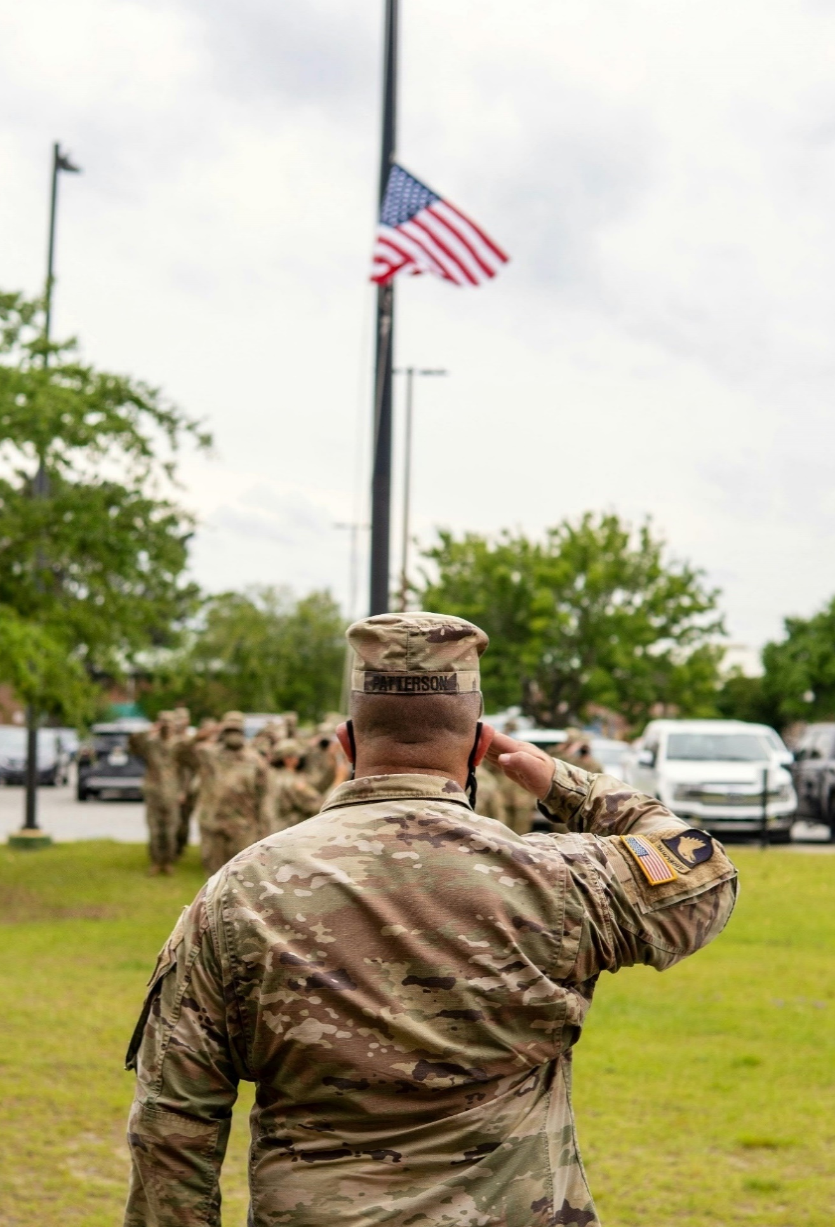
Article 12 – Veterans Disability Tax Credit Increase
To see if the Town shall vote, pursuant to RSA 72:35, to increase the amount of the tax credit for service-connected permanent and total disability to Four Thousand Five Hundred Dollars ($4,500). (Recommended by the Board of Selectmen, 3 in favor, 0 opposed). Recommended by the Budget Advisory Committee, 7 in favor, 0 opposed).

Slide 23
Article 12 – Veterans Disability Tax Credit Increase
This warrant article is in response to a law change (HB 99, effective 07/13/2025) that eliminates the ability to combine the permanent and total disability credit of $4000 with the optional veteran’s credit of $500. If this article passes, the total credit received by veterans who previously combined both credits will remain the same at $4500. If this article passes, it will not affect current taxation.

Slide 24
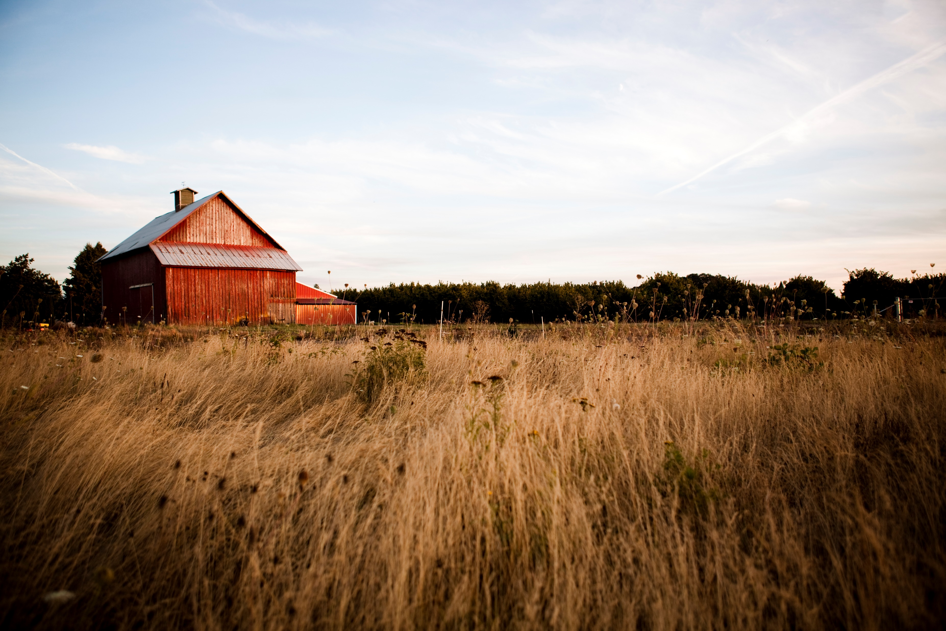
Article 13 – Adoption of Farm Structure Exemption
To see if the Town shall vote to adopt the provisions of RSA 79F regarding the taxation of farm structures, as defined in RSA 79-F:3, and the land under farm structures (Recommended by the Board of Selectmen, 3 in favor, 0 opposed). Recommended by the Budget Advisory Committee, 7 in favor, 0 opposed).

Slide 25
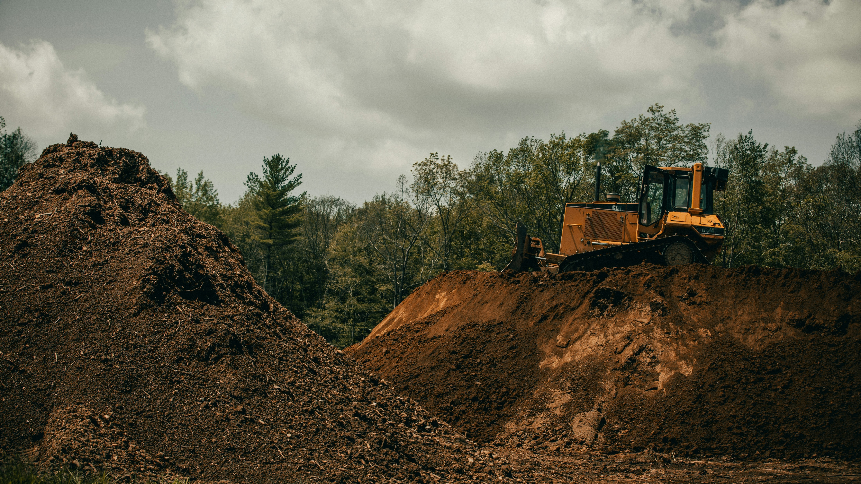
Article 14 – Land Use Change Tax
To see if the Town shall vote to amend the percentage of Land Use Change Tax revenue deposited into the Conservation Fund to Twenty Percent, pursuant to RSA 79-A:25, IV? (Recommended by the Board of Selectmen, 3 in favor, 0 opposed). Recommended by the Budget Advisory Committee, 1 in favor, 6 opposed).

Slide 26
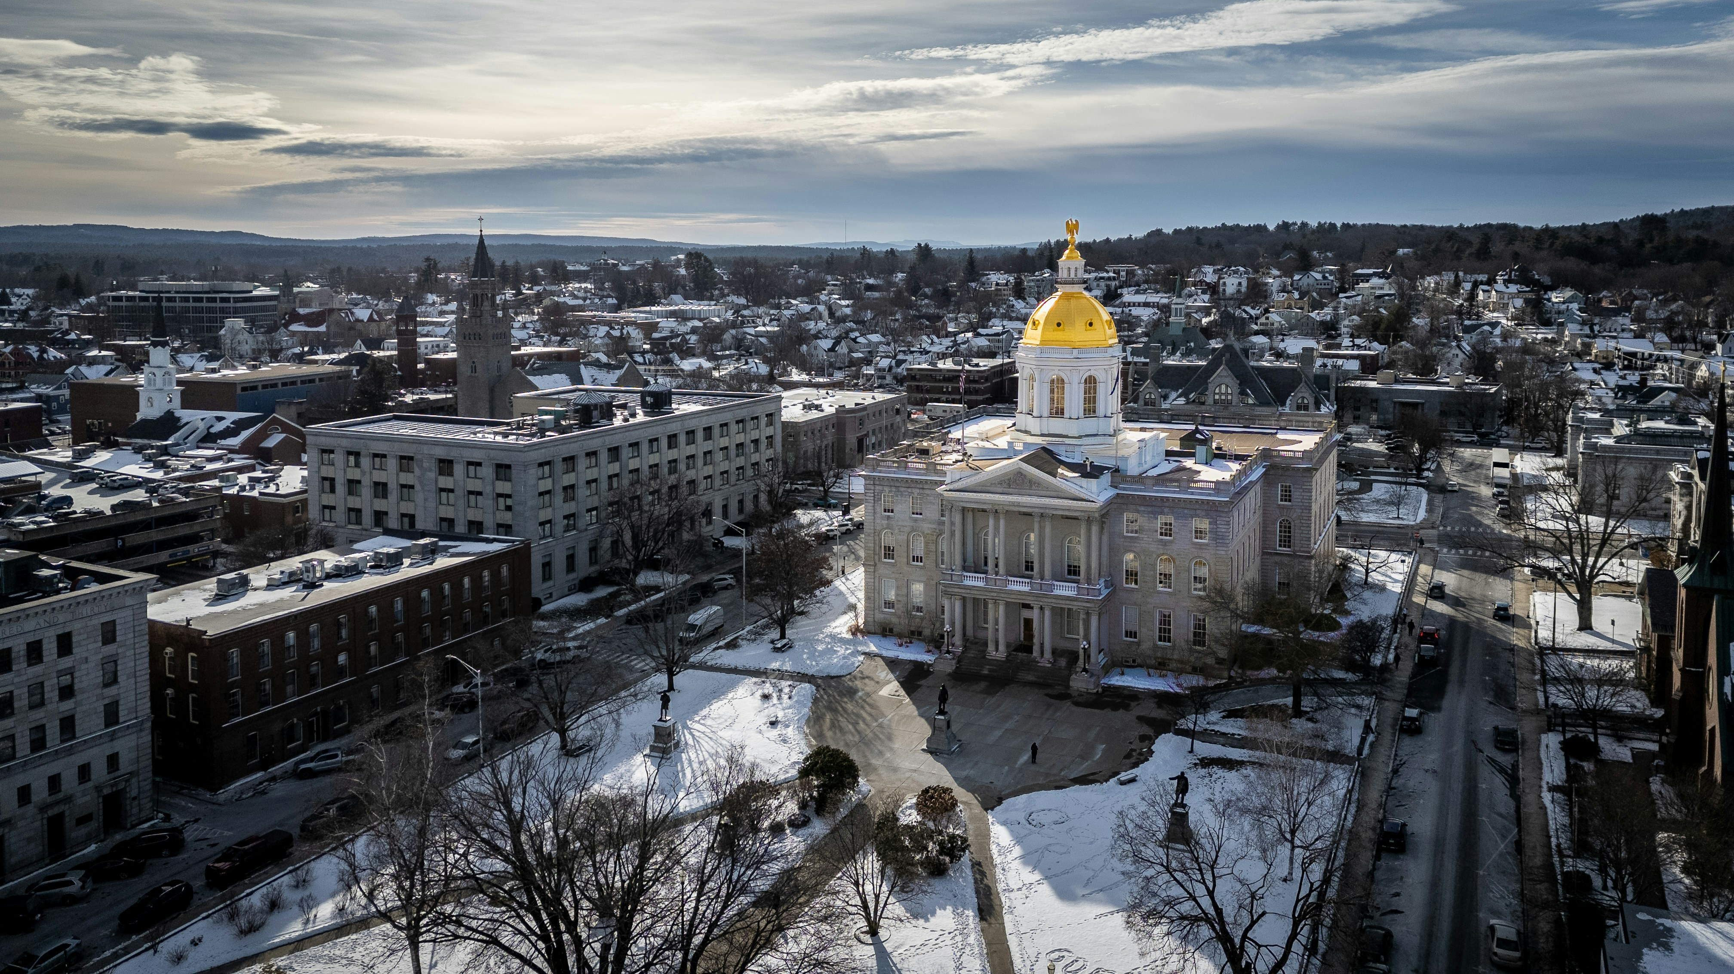
Article 15 – Protect the Taxpayer (Petition)
To see if the Town will vote to call on the New Hampshire Legislature to protect local taxpayers by ensuring adequate state revenues for the essential services and by avoiding policies that shift costs onto local taxpayers. Further resolved, if this article passes, the Select Board shall send the results of this vote to the Governor and all members of the New Hampshire General Court who represent the Town within 30 days of the second session of the 2026 Town Meeting.

Slide 27

Article 16 – Rescind Ninth Police Officer Position (Petition)
To see if the Town shall vote to rescind Article 17 of the Rindge Town Warrant of March 9th, 2021, authorizing the hiring of a ninth Full-Time Police Officer thereby returning the authority to determine the number of Full-Time Police Officers needed to the Board of Selectmen.

Slide 28
Thank You All For Coming Today!
The Voting Session will be on TUESDAY, MARCH 10th, 2026, from 7:00 am to 7:00 pm In the Rindge Memorial School Gymnasium, at 58 School Street, Rindge, NH

